Slide 1




Atliq Hardware Ad_Hoc Insights
Domain: Consumer goods
Created By: Sutapa Ghosh

Slide 2

AGENDA
ABOUT PROJECT
ABOUT COMPANY
INPUT DATASET
RESOLUTION

Slide 3
1
ABOUT PROJECT

Slide 4
ABOUT PROJECT
INTRODUCTION : Atliq Hardwares (imaginary company) is one of the leading computer hardware producers in India and well expanded in other countries too.
PROBLEM : The management noticed that they do not get enough insights to make quick and smart data-informed decisions.
TASKS : 1. There are 10 ad hoc requests for which the business needs insights. 2.You need to run a SQL query to answer these requests.

Slide 5

2
ABOUT COMPANY

Slide 6
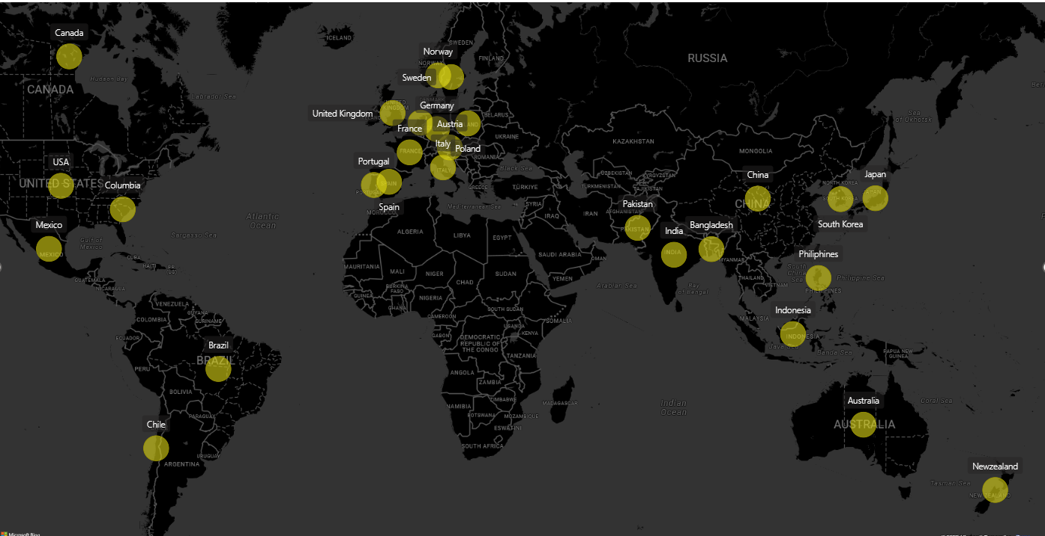
COMPANY NETWORK

Slide 7
COMPANY PRODUCTS
PC
P&A
N&S
DESKTOP
ACCESSORIES
NETWORKING
Business Laptop
Key board
WIFI Extender
Personal Laptop
Mouse
Batteries
NETWORK
PERIPHERALS
STORAGE
Personal Laptop
Graphic card
External SSD
Gaming Laptop
USB Flash Driver
Internal HDD
Business Laptop
Processor

Slide 8

3
INPUT DATASET

Slide 9
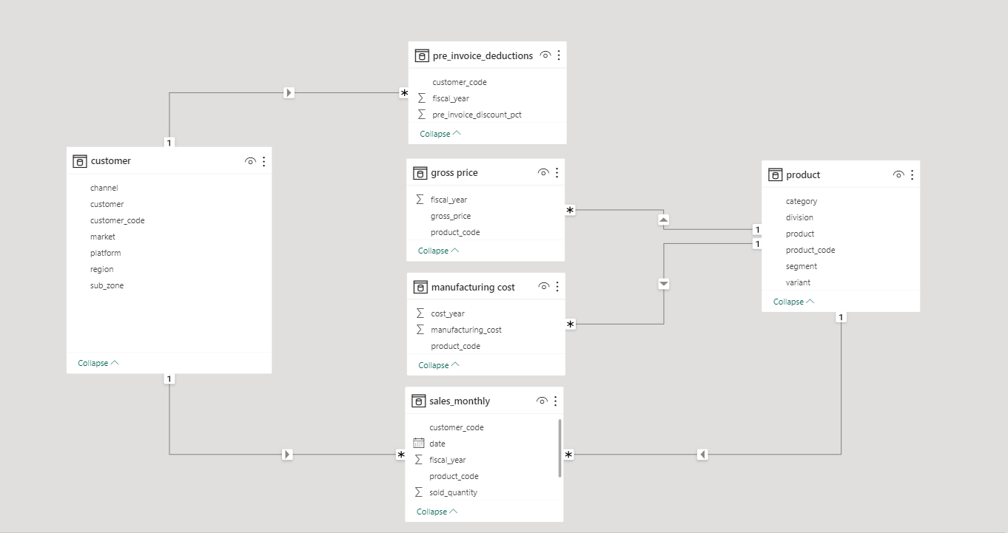
INPUT DATASET

Slide 10

3
RESOLUTION

Slide 11
QUERY 1
OUTCOME
Provide the list of markets in which customer "Atliq Exclusive" operates its business in the APAC region.
CUSTOMER | MARKET | REGION
Atliq Exclusive | India | APAC
Atliq Exclusive | Indonesia | APAC
Atliq Exclusive | Japan | APAC
Atliq Exclusive | Philiphines | APAC
Atliq Exclusive | South Korea | APAC
Atliq Exclusive | Australia | APAC
Atliq Exclusive | Newzealand | APAC
Atliq Exclusive | Bangladesh | APAC

Slide 12
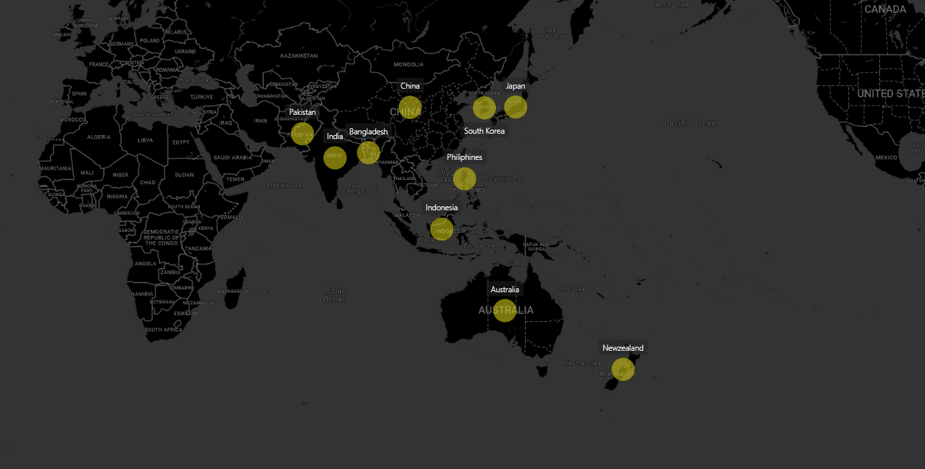
MARKET IN APAC REGION

Slide 13
QUERY 2
OUTCOME
What is the percentage of unique product increase in 2021 vs. 2020? The final output contains these fields,
unique_products_2020 unique_products_202
percentage_chg
Unique Products 2020 | Unique Products 2021 | Percentage
245 | 334 | 36.33

Slide 14
GRAPHICAL REPRESNTATION
BRIEF
36.33%
The unique products number in 2020 is 245 and in 2021 is 334.
So,the percentage change is 36.33 %.

Slide 15
QUERY 3
OUTCOME
Provide a report with all the unique product counts for each segment
and sort them in descending order
Of product counts. The final output contains 2 fields,
SEGMENT | PRODUCT_COUNT
Notebook | 129
Accessories | 116
Peripherals | 84
Desktop | 32
Storage | 27
Networking | 9
segment ,
product_count.

Slide 16
GRAPHICAL REPRESNTATION
BRIEF
The unique products count
Is high in Notebook, Accessories, Peripherals category rather than Desktop,Storage,Networking.

Slide 17
QUERY 4
Which segment had the most increase in unique products in 2021 vs 2020? The final output contains these fields,
OUTCOME
Segment Product_count_2020 Product_count_2021 Difference.
SEGMENT | PRODUCT_COUNT 2020 | PRODUT_COUNT 2021 | DIFFERENCE
Desktop | 7 | 22 | 2.1429

Slide 18
GRAPHICAL REPRESNTATION
BRIEF
The Desktop segment had the most increase in unique products in 2021 vs 2020.The increment is about 2.12%
2.12%

Slide 19
Get the products that have the highest and lowest manufacturing costs.The final output contains these fields,
QUERY 5
OUTCOME
Product_code
Product
Manufacturing_cost
PRODUCT_CODE | PRODUCT | MANUFACTURING COST
A2118150101 | AQ Master wired x1 Ms | 0.8920
A6120110206 | AQ HOME Allin1 Gen 2 | 240.5364

Slide 20


COST COMPARISON
$.89
$.240.5
Manufacturing cost is heighest for AQ HOME Allin1 Gen 2
Manufacturing cost is lowest for AQ Master Wired X1 Ms

Slide 21
Generate a report which contains the top 5 customers who received an average high pre_invoice_discount_pct for the fiscal year 2021 and in the Indian market. The final output contains these fields,
QUERY 6
OUTCOME
CUSTOMER_CODE | CUSTOMER | AVERAGE_DISCOUNT PCT
90002009 | Flipkart | 0.3083
90002006 | Viveks | 0.3038
90002003 | Ezone | 0.3028
90002002 | Croma | 0.3025
90002016 | Amazon | 0.2933
Customer_code
Customer Average_discount_pct

Slide 22
GRAPHICAL REPRESNTATION
BRIEF
The Top 5 customer are Flipkart,Viveks,Ezone,Croma,Amazon. This customers received high discount percentage.

Slide 23
Get the complete report of the Gross sales amount for the customer “Atliq Exclusive” for each month . This analysis helps to get an idea of low and high-performing months and take strategic decisions.The final output contains these fields,
QUERY 7
OUTCOME
MONTH | YEAR | GROSS_SALES AMOUNT
September | 2019 | 9092700
October | 2019 | 10378600
November | 2019 | 15231900
December | 2019 | 9755800
September | 2020 | 19530300
October | 2020 | 21016200
November | 2020 | 32247300
May | 2020 | 1587000
March | 2020 | 767000
June | 2020 | 3429700
July | 2020 | 5151800
January | 2020 | 9585000
February | 2020 | 8084000
December | 2020 | 20409100
August | 2020 | 5638300
April | 2020 | 800100
May | 2021 | 19204300
Month Year Gross sales Amount

Slide 25
In which quarter of 2020, got the maximum total_sold_quantity? The final output contains these fields sorted by ,
QUERY 8
OUTCOME
QUARTER | TOTAL SOLD QUANTITY
Q1 | 1764002
Q1 | 2190792
Q1 | 3050825
Q2 | 3184205
Q2 | 1762652
Q2 | 1702785
Q3 | 23861
Q3 | 819956
Q3 | 1016170
Q4 | 1559773
Q4 | 1692575
Q4 | 1790193
Quarter total_sold_quantity

Slide 26
GRAPHICAL REPRESNTATION
BRIEF
In the first quarter of 2020 (1st September 1995 to 1st November 2019), total_sold_quantity was maximum.
1.8M
7M
6.6M
5M

Slide 27
Which channel helped to bring more gross sales in the fiscal year 2021 and the percentage of contribution? The final output contains these fields,
QUERY 9
OUTCOME
channel gross_sales_mln percentage
CHANNEL | GROSS SALE | PERCENTAGE
Retailer | 2690556298.9562 | 72.5

Slide 28
Retailer channel helped to bring more gross sales in the fiscal year 2021 and the percentage of contribution is 72.5%.
GRAPHICAL REPRESNTATION
BRIEF

Slide 29
Get the Top 3 products in each division that have a high total_sold_quantity in the fiscal_year 2021? The final output contains these fields,
QUERY 10
OUTCOME
DIVISION | PRODUCT_CODE | RANK
N&S | A6720160103 | 1
N&S | A6818160202 | 2
N&S | A6819160203 | 3
P&A | A2319150302 | 1
P&A | A2520150501 | 2
P&A | A2520150504 | 3
PC | A4218110202 | 1
PC | A4319110306 | 2
PC | A4218110208 | 3
Division Product_code Rank

Slide 30
GRAPHICAL REPRESNTATION
USB Drives are the most selling
Mouse are the most selling
Personal laptop are the most selling

Slide 31
THANK YOU

